Slide 1
Can you please pass the data?
IoT communication in Micropython
Sev Leonard
PyCascades 2018
@gizm0_0.tenforward.social

Slide 2

Hello!
Portland, OR
Trans guy, trans masc slack
Oregon Health & Science University
He/Him
Internet of Cats (PyDX 2016), IoT with Micropython and Friends (PyCon 2017)
Notes:
Portlandian where I live with my partner and our cat
Trans guy- not a lot of us in tech
Sadly no (or very little) snake language at my current job
Prior micropython talks include…

Slide 3


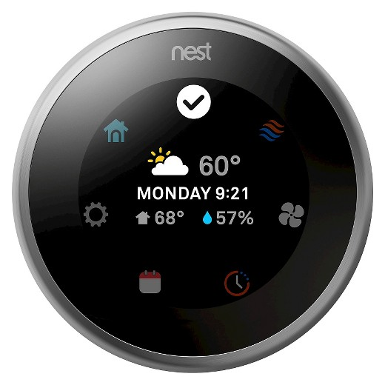
IoT Communication
Wow look at the time! My elderly mom from Florida will be here soon. I wonder what the temperature is at the house.
Its 60 degrees
You betchya
Hey Nest, whats the temp?
Yikes! Can you turn it up to 78 please?
Notes:
The focus of this talk is how devices communicate with eachother, so lets have an imaginary IoT conversation
So, the internet of things.
An internet
A thing
A humanoid with fancy internet connected devices
We’re going to explore how devices like the Nest can pass messages using a very simple protocol (not email or HTTP based)

Slide 4

Vine 1
Vine 4
Vine 2
Vine 3
Photo: Willamette Valley Vineyards http://www.wvv.com
Notes:
The previous example showed communication with a single device, but IoT is really about communicating with many devices. So, lets imagine we own a vineyard. Being concientious grape farmers we want to know what the micro climates are like in different areas of the vineyard. So we deploy sensors at each vine to track this.
Im going to be demoing some temp and humidity sensors that we can imagine are part of a vineyard IoT network
If its too cold, we may need to turn on some heaters out in the vineyard
if its too hot for an extended period, we may need to rethink next years wine offerings or look into purchasing grapes

Slide 5
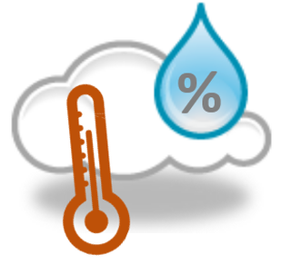

Our Internet of Things
vineyard_network
vine1
vine2
Notes:
We will use one ESP 8266 to provide the wifi for our sensors
We have 2 sensors, on vine 1 and vine2
We have the laptop that will monitor the conditions in the vineyard
And then the sensors will send the temp and humidity over the wireless to the laptop

Slide 6
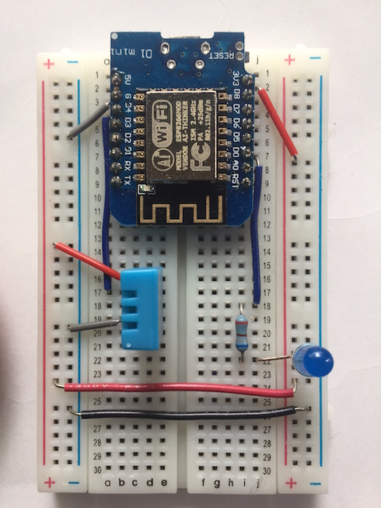
Vine Sensor
ESP8266
DHT11
LED
Notes:
ESP 8266 - WiFi enabled microcontroller. Can both act as an access point, broadcasting a network to connect to , and as a station - an element that connects to and communicates over a wireless network

Slide 7
Vineyard Network
ESP8266
vineyard_network
vine1
vine2
Notes:
We will use one ESP 8266 to provide the wifi for our sensors
We have 2 vine sensors - the ESP with the DHT, on vine 1 and vine2
We have the laptop that will monitor the conditions in the vineyard
And then the sensors will send the temp and humidity over the wireless to the laptop

Slide 8
Setup WiFi
1 import network
2 ap_if = network.WLAN(network.AP_IF)
3 ap_if.config(essid=’vineyard_network’)
4 ap_if.active(True)
ESP8266
Notes:
We’re going to setup the vineyard_network, so we will program and ESP to run as a wireless access point
Using the network module, we can create a wireless access point interface

Slide 9
Connect vine sensors
1 import network
2 sta_if = network.WLAN(network.STA_IF)
3 sta_if.active(True)
4 sta_if.connect(‘vineyard_network’,password)
vine1
Notes:
The vine sensors will connect to the vineyard_network as wireless stations, so we will use the network module to create station interfaces like this
First, active the station interface
Then, connect the station to the network

Slide 10
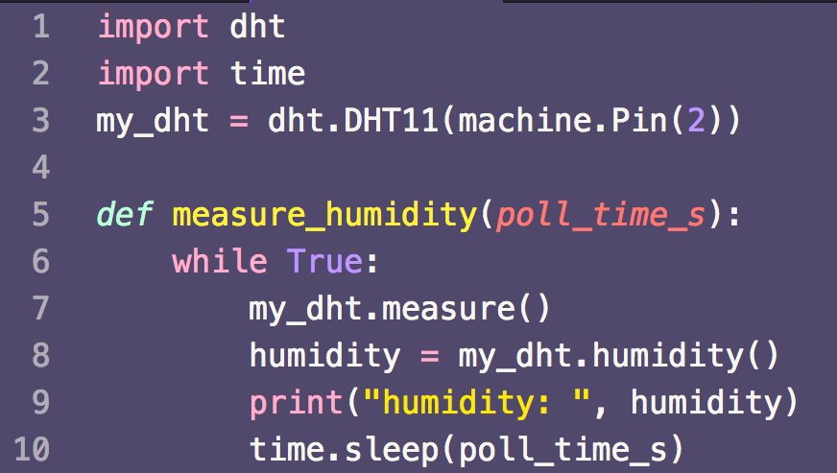
Measuring humidity
Notes:
Based on Python3
Load files to be executed
Some standard python like things (time)
Some hardware things (DHT - digital humidity temp sensor) and PIN - turn the LEDs on and off

Slide 11

Vineyard Network
ESP8266
vineyard_network
vine1
vine2
Notes:
Now, we have the vineyard network access point running
We have the vine sensors connected to the network
AND we have the vine sensors recording the humidity (and temp)
Our computer is still excitedly waiting for the data from the sensors
How will we get the data there?

Slide 12

MQTT
Message Queuing Telemetry Transport!
Light weight, pub/sub model w/ broker
sub
pub
msg
Notes:
MQTT - originally designed in 1999 to monitor oil pipelines, it is low power and low bandwidth
Publish / Subscribe model
Easy to scale - just set topics accordingly when new devices are added to the network
Mosquitto broker - open source MQTT broker with a nice python API
Now, our laptop can tell the broker ‘hey i want to subscribe to vineyard temp and humidity’
The sensors say ‘hey broker, i have some temp and humidity data to publish’
Then the broker says ‘hey laptop - heres some data for you’

Slide 13
MQTT - Topics
vineyard/
vineyard/humidity
vineyard/humidity/vine1
vineyard/temp/#
vineyard/+/vine1
Notes:
Maybe you want to subscribe to all vineyard MQTT topics.
… maybe just temp
… maybe just temp for a subset of vines
the + acts like a wildcard within a topic, so vineyard/+/vine1 would subscribe to all topics related to vine1

Slide 14
MQTT Pub in Micropython
1 from umqtt.simple import MQTTClient
2 p = MQTTClient( client_id, broker_ip )
3 p.connect()
4 p.publish( vineyard/temp/vine1, 15 )
Notes:
create an MQTT client pointed at the IP address of the broker, first param is client id

Slide 15
MQTT Sub in Micropython
1 s = MQTTClient( client_id, broker_ip )
2 s.connect()
3 def cb(topic, message): 4 print(topic + ": " + message)
Notes:
Setup mqttt client as with pub
To subscribe, first we need a callback function to handle the message
creating an MQTT client sub using the same procedure as the preceeding slide
set the call back
subscribe to the topic (# is a wildcard to listen to any sub topics)
wait for messages

Slide 16
MQTT Sub in Micropython
1 s.set_callback(cb)
2 s.subscribe(”vineyard/temp/#”)
3 while 1:
4 s.wait_msg()
Notes:
Setup mqttt client as with pub
To subscribe, first we need a callback function to handle the message
creating an MQTT client sub using the same procedure as the preceeding slide
set the call back
subscribe to the topic (# is a wildcard to listen to any sub topics)
wait for messages

Slide 17
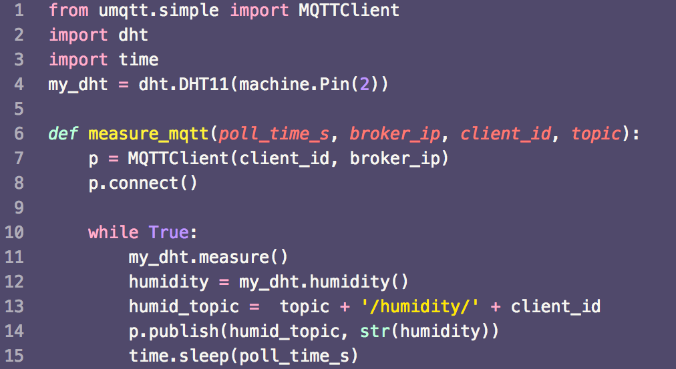
Notes:
Lets revisit our humidity measuring function, now with MQTT
The real code has a lot of try/except and garbage collection

Slide 18
Demo!
from mqtt_measure import *
measure_mqtt(4, "192.168.4.2", "vine1", "vineyard")
from mqtt_measure import *
measure_mqtt(4, "192.168.4.2", "vine2", "vineyard")

Slide 19
Summary
Create WLAN access point
Connect sensors to WLAN
Measure humidity and temperature
MQTT for message relay

Slide 20
Thanks!
References in backup
gizm0_0@tenforward.social
github.com/gizm00/pycascades_2018
sev@thedatascout.com

Slide 21
Backup

Slide 22
Demo setup
connect laptop to vineyard_network
ipconfig | grep inet
pico /usr/local/Cellar/mosquitto/1.4.11_2/etc/mosquitto/mosquitto.conf
brew services restart mosquitto
mosquitto_sub -h 192.168.4.2 -t vineyard/#
nav webrepl to 192.168.4.3 and 4.4 to get to vine sensors
from mqtt_measure import *
measure_mqtt(4, "192.168.4.2", "vine1", "vineyard")
from mqtt_measure import *
measure_mqtt(4, "192.168.4.2", "vine2", "vineyard")

Slide 23
MQTT Spy Setup
Goto Connections -> Manage Connections
Update Server URI if needed
Click “Close and reopen existing connections”
Under subscriptions & received messages click New tab
Add vineyard/temp/#
Add vineyard/humidity/#
To show graphs:
Right click received messages and go to Charts
Show all browsed topics

Slide 24
References
https://en.wikipedia.org/wiki/MQTT
https://mosquitto.org
https://micropython.org
https://www.hivemq.com/blog/how-to-get-started-with-mqtt

Slide 25
Agenda
IoT IRL
ESP8266
Micropython
MQTT
Sending MQTT messages
Demo!
Notes:
MQTT - a protocol for IoT communication

Slide 26

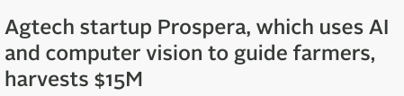


Agricultural Technology
Notes:
Tech crunch headlines from 2017
Prospera: Tel-Aviv based startup using sensors, computer vision, and AI to improve farm yields
Ceres: Oakland based startup using sensors & cameras to pinpoint crop stress
Vinsight: Redwood City based startup collecting data from sensors, satellites and weather stations to correlate with crop health
Not just startups - Independence Oregon working to become an ag-tech innovation hub
City provided gigabit broadband for every home and business
Farm and vineyard partners to be test sites
Focused on drones and imaging, also sensor based data

Slide 27
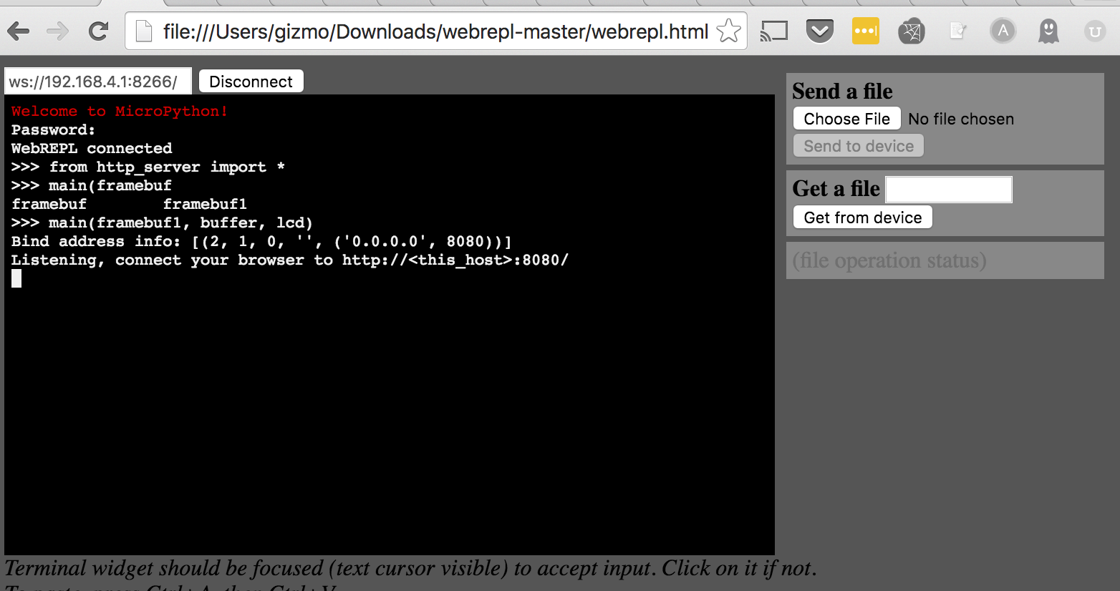
WebREPL
Notes:
REPL - read evaluate print loop
Basically any shell you’ve used is a REPL
Allows hardware to be programmed over wireless, can bypass driver installation

Slide 28

Micropython
Like regular Python, but small and hard to read
A version of Python optimized for use on microcontrollers Funded via Kickstarter
All of the above
Some of the above
E. Some of the above!
micropython.org
X
Notes:
Micropython is a version of Python3 optimized to run on microcontrollers
Lots of great docs on micropython.org

Slide 29
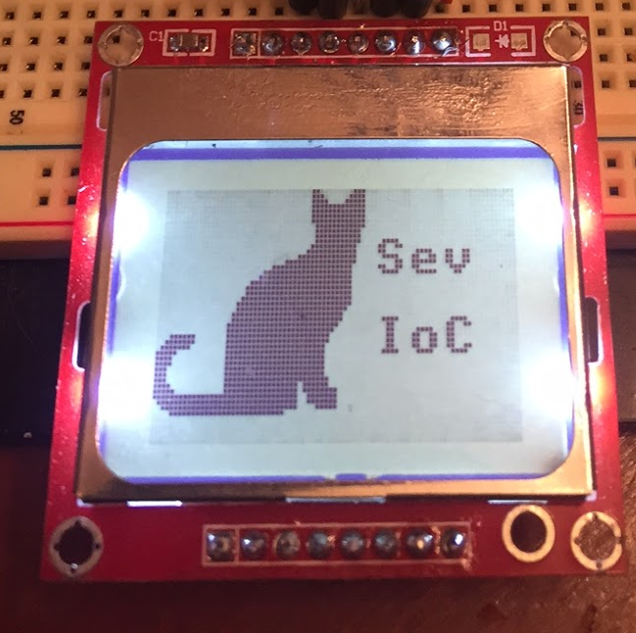

ESP 8266 Microcontroller
ESP8266
(WeMos D1)
Antenna
DHT11
Digital Humidity
Temperature sensor
LED
Access Point
Station
Station
Notes:
Prototype board with the ESP and some additional friends.
Microcontroller - specialized system that includes a microprocessor, memory & I/O targeted to a specific application.
ESP is a microcontroller with WiFi, and is capable of both providing network access as an Access Point, and connecting to an existing network as a station IMPORTANT FOR OUR TALK
You can run a web server …
This is a development board, WeMos, for the ESP8266
- provides nice things like Reset, onboard LED, microUSB connection
In addition to the internet, the ESP can drive displays using the GPIO pins
And if you combine the wifi functionality and the display you can create the Internet of Cats - HTTP request a cat pic and have it delivered to you at the speed of pixel rendering

Slide 30
Vineyard Sensors
ESP 8266 Microcontroller
WiFi enabled
3.3V
Digital Humdity and Temperature Sensor DHT 11
5 USD
Notes:
Vineyard sensor - sense temp and humidity and relay that information
Microcontroller - specialized system that includes a microprocessor, memory & I/O targeted to a specific application.
ESP is a microcontroller with WiFi, and is capable of both providing network access as an Access Point, and connecting to an existing network as a station IMPORTANT FOR OUR TALK
You can run a web server …
This is a development board, WeMos, for the ESP8266
- provides nice things like Reset, onboard LED, microUSB connection
In addition to the internet, the ESP can drive displays using the GPIO pins
And if you combine the wifi functionality and the display you can create the Internet of Cats - HTTP request a cat pic and have it delivered to you at the speed of pixel rendering

